Slide 1
Spring Framework
Introduction

Slide 2
Why????
Main advantage
Dependency Injection
Wide variety of modules (around 20)
Spring JDBC
Spring MVC
Spring AOP
Spring ORM
Spring JMS
Spring Test
Good integration with other frameworks
Hibernate
Junit/Mockito
Etc etc..

Slide 3
End benefits
You focus on the actual project implementation
Provides clean architecture OTG.
Loosely coupled code.
Inversion of control.
Unit testing becomes easy

Slide 4
Dependency injection
When a class is having an object of another class. It becomes dependent on the implementation of that object. Which introduces “Tight coupling” and “Low cohesion”.
What's wrong with Tight Coupling???
In all terms, we do not want this kind of situation to come.
It makes code very complex and resistant to change in the future.

Slide 5
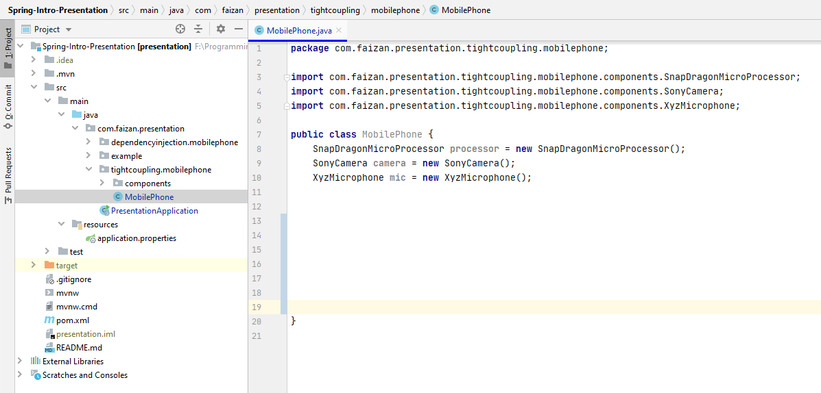
Code Example – Tightly Coupled
When any of these modules (processor, camera or mic) will change
then,
- This mobile phone class will have to go through modifications
because of Tight coupling.

Slide 6
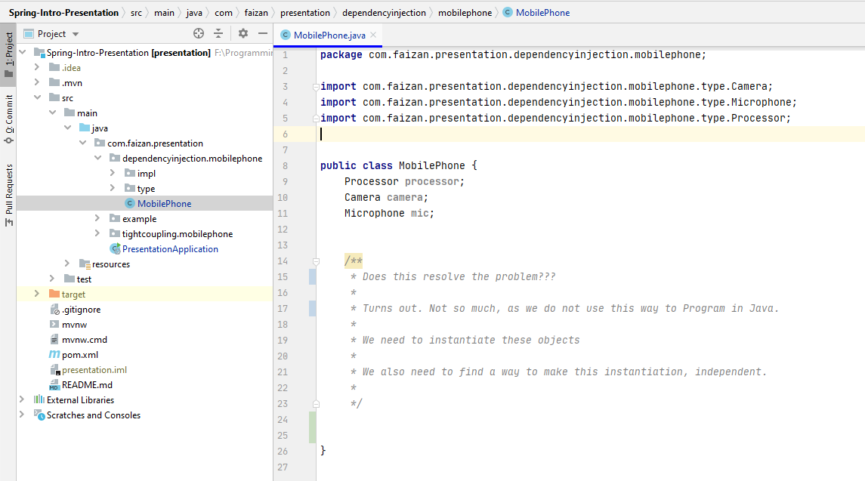
Code Example –No Coupling

Slide 7
How does spring handle it???
@Autowire
@Component
Spring Container

Slide 8
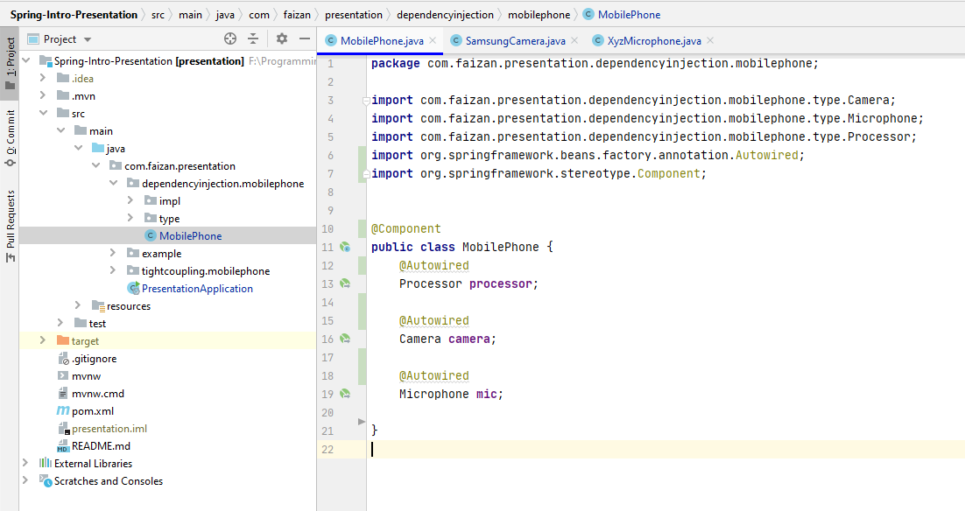
Dependency injection –Code Example

Slide 9
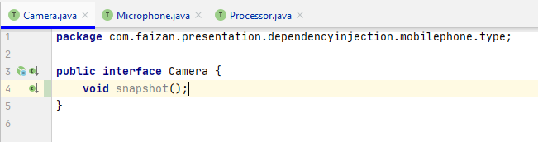
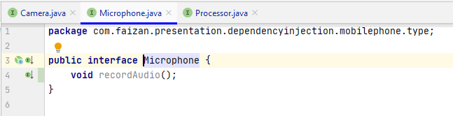
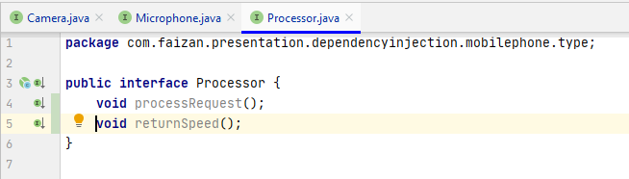
Dependency injection –Code Example
Interfaces

Slide 10
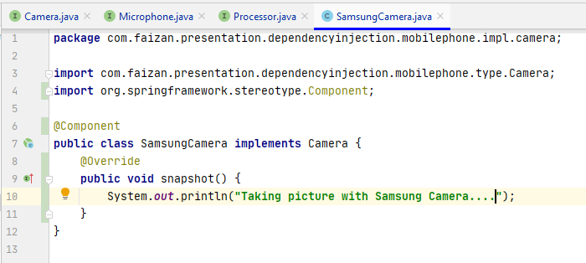
Dependency injection –Code Example

Slide 11
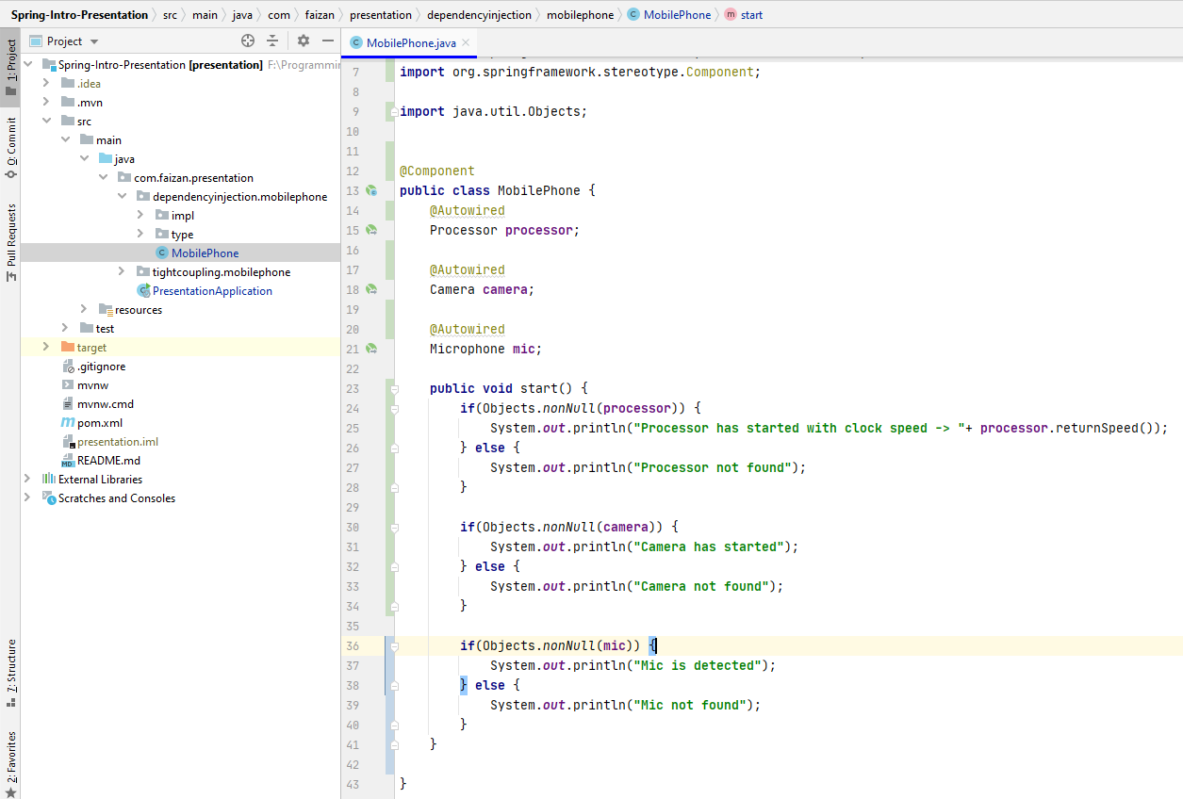
Dependency injection –Code Example

Slide 12
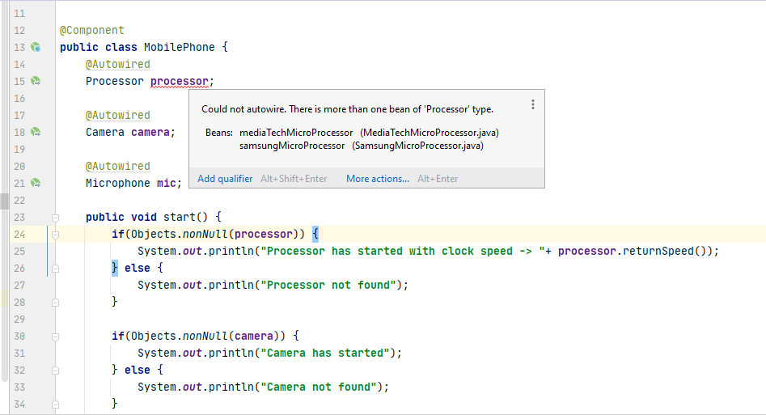
If you have more than 1 implementations, then Spring will throw an error.

Slide 13
Why Spring boot?

Slide 14
Why spring boot?
Extension of Spring Framework
No boiler plate configurations
Embedded server

Slide 15

Spring vs Spring boot
A comparison

Slide 16

Let’s create a simple web app using
Spring
Spring boot

Slide 17
Spring vs Spring boot
The dependencies

Slide 18
Dependencies
Spring
Spring boot
spring-web
spring-webmvc
spring-boot-starter-web
spring-boot-starter-data-jpa
spring-boot-starter-security
spring-boot-starter-test
spring-boot-starter-web
spring-boot-starter-thymeleaf

Slide 19
Spring vs Spring boot
Extra configurations for a simple JSP Web app

Slide 20
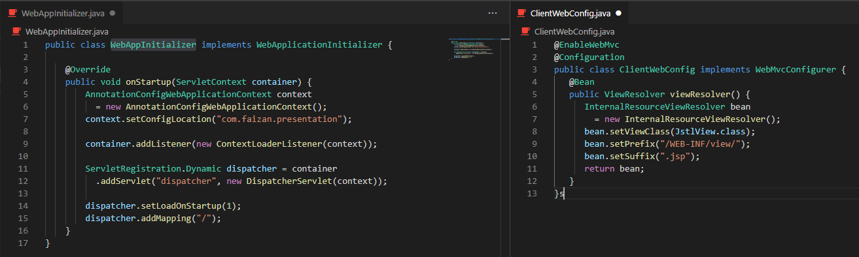
Spring App

Slide 21
Spring boot
Just add a couple of properties to make things work.
spring.mvc.view.prefix=/WEB-INF/jsp/, spring.mvc.view.suffix=.jsp
SPRING Boot - Auto Configuration

Slide 22
Spring vs Spring boot
The template engine - thymeleaf

Slide 23
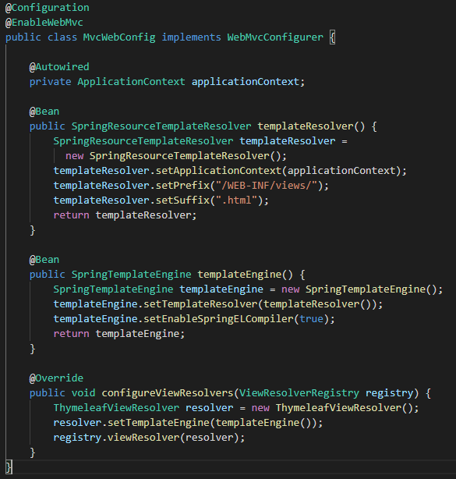
Spring App
thymeleaf-spring5 dependency needs to be added.

Slide 24
Spring boot
Add some dependencies for thymeleaf
Add the templates to the src/main/resources/templates

Slide 25
Spring vs Spring boot
Spring vs Spring boot
Configurations for Spring Security
Spring Security Configurations
We will just discuss the
Default HTTP Basic authentication

Slide 26
Spring
Dependencies and configuration, we need to enable Security using Spring.
spring-security-web
spring-security-config

Slide 27
SPRING BOOT - Security
Just one dependency needs to be added
spring-boot-starter-security

Slide 28
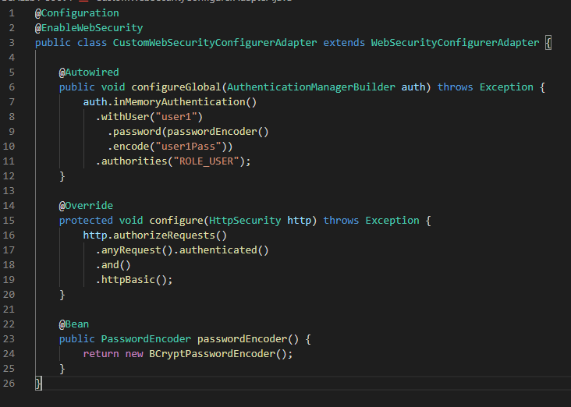
Spring & Spring boot

Slide 29
Spring vs Spring boot
Spring vs Spring boot
Configurations for Spring Security
Running the application.
Entry points etc.

Slide 30
Spring
Spring reads web.xml
Then extracts and instantiates the DispatcherServlet defined in the web.xml
Spring reads WEB-INF/{servletName}-servlet.xml to create WebApplicationContext
Then, Beans gets registered

Slide 31
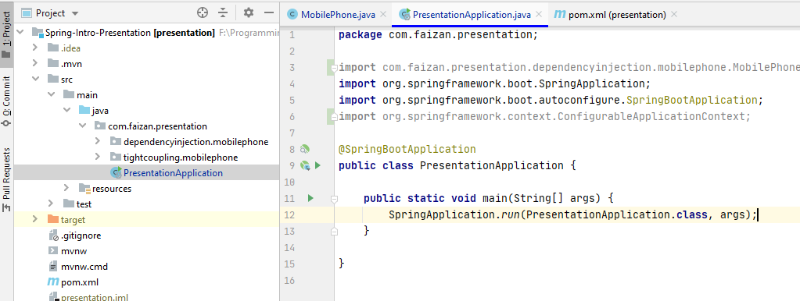
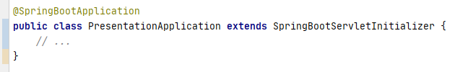
Spring boot
Deploying as a web archive in an external container

Slide 32
Spring vs Spring boot
Spring vs Spring boot
Configurations for Spring Security
Deployment

Slide 33
Spring Boot is better
It comes with embedded container support.
Provision to run the jars independently using the command java -jar

Slide 34
LET'S Create OUR OWN WEB APPLICATION
Using Spring Boot.

Slide 35
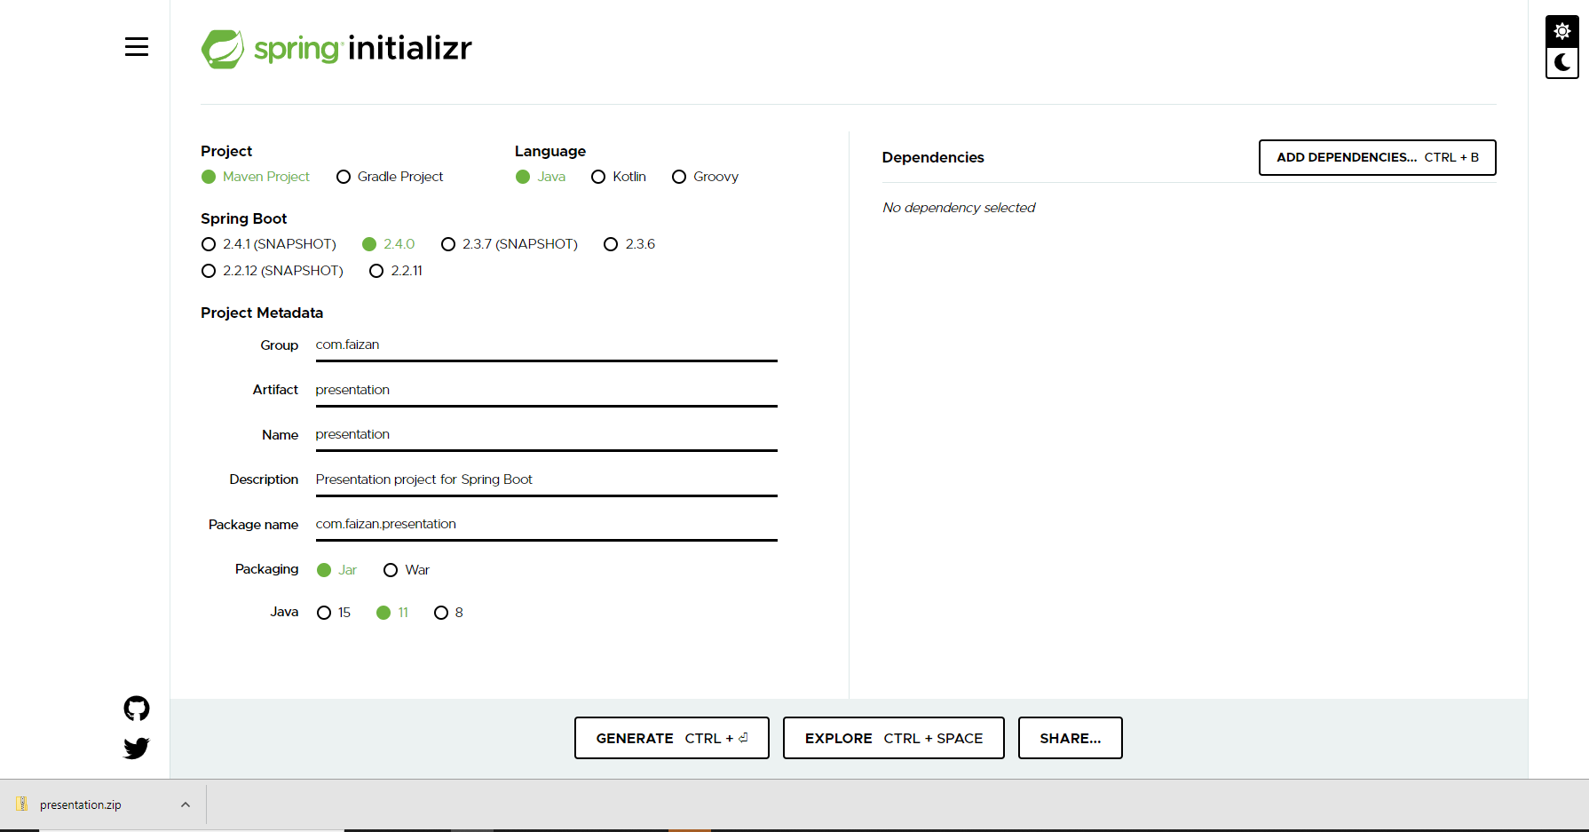
Use Spring Initializer tool

Slide 36
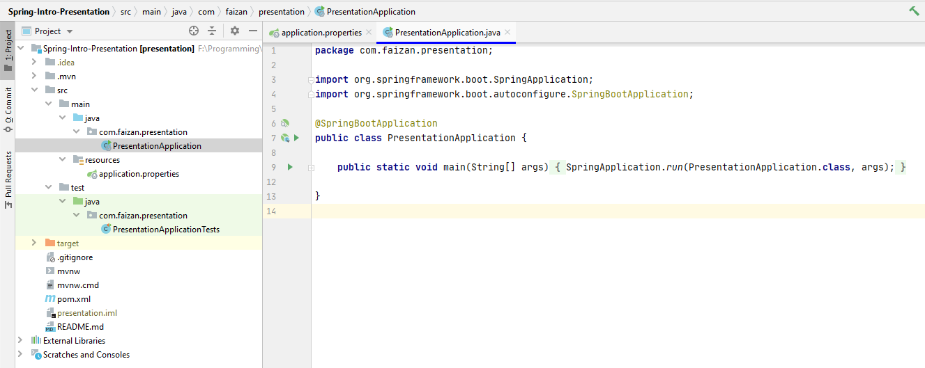
Import the project into IDE

Slide 37
Required dependencies
spring-boot-starter-web
spring-boot-starter-security
spring-boot-starter-thymeleaf
spring-boot-starter-data-jpa
h2

Slide 38
Application Properties
server.port=8081
event.owner=Fraunhofer-IEM
main.heading=SPRING FRAMEWORK
sub.heading=INTRODUCTION

Slide 39
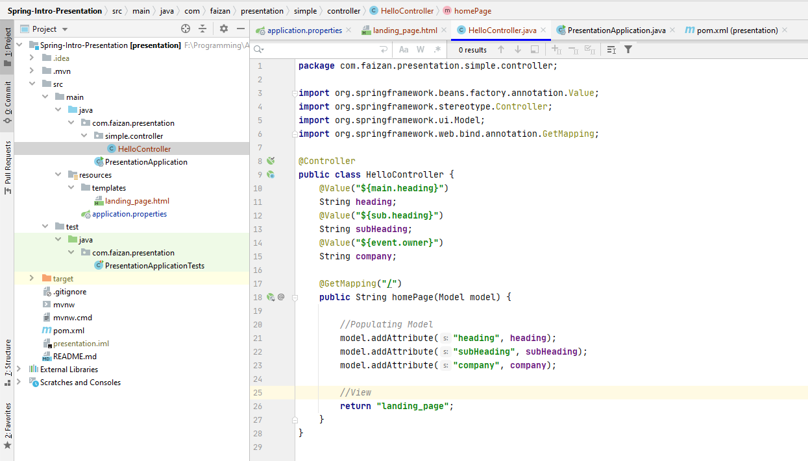
MVC Architecture IN spring boot
Defining a controller & Setting model for View

Slide 40
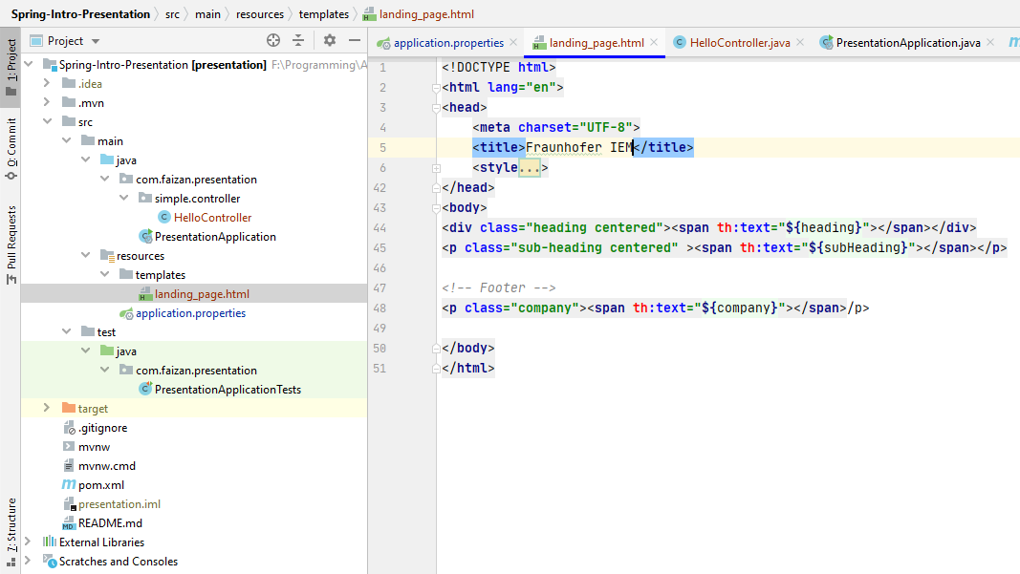
MVC Architecture in spring boot continues
Defining View – using thymeleaf

Slide 41
Taking application to the next level
Perform CRUD Operations
CREATE, READ, UPDATE and DELETE
Use of Different HTTP Methods
POST, PUT, GET and DELETE

Slide 42
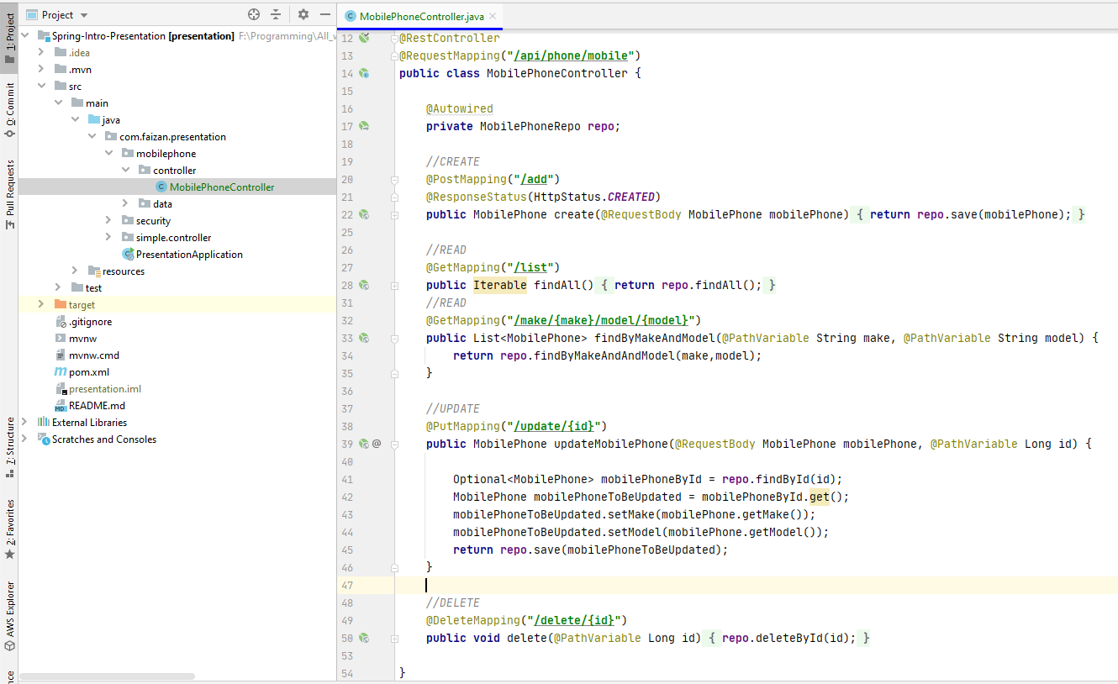
HTTP Methods & CRUD OPERATIONS

Slide 43
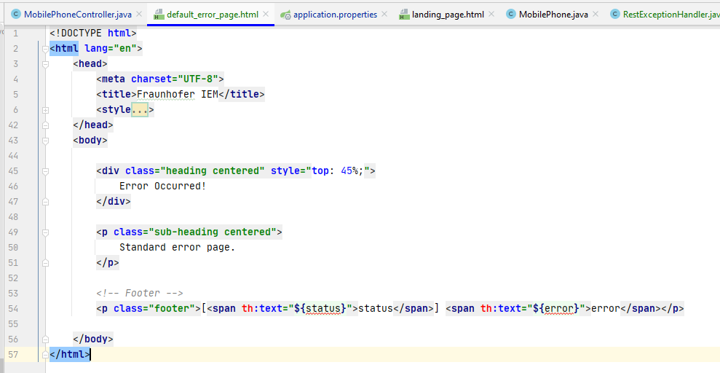
error handling
Added a simple default error page.
App Property -> server.error.path=/default_error_page

Slide 44
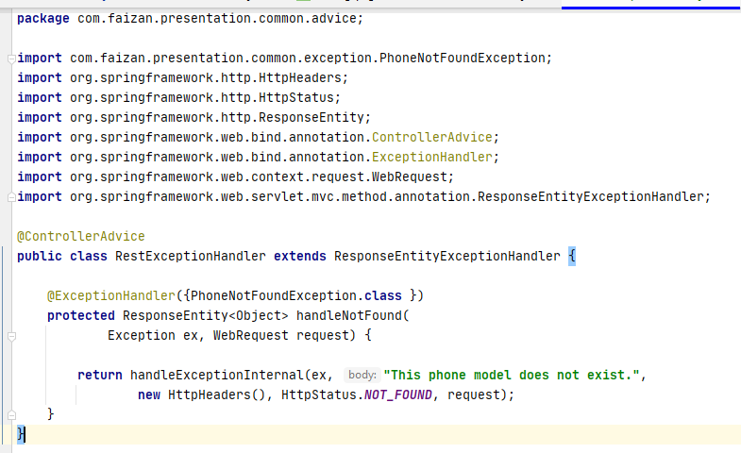
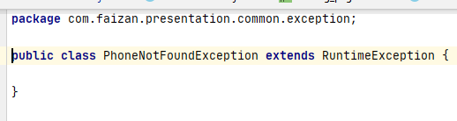
Exception handling
A Controller Advice using @ControllerAdvice
An exception class to trigger a specific controller advice.

Slide 45
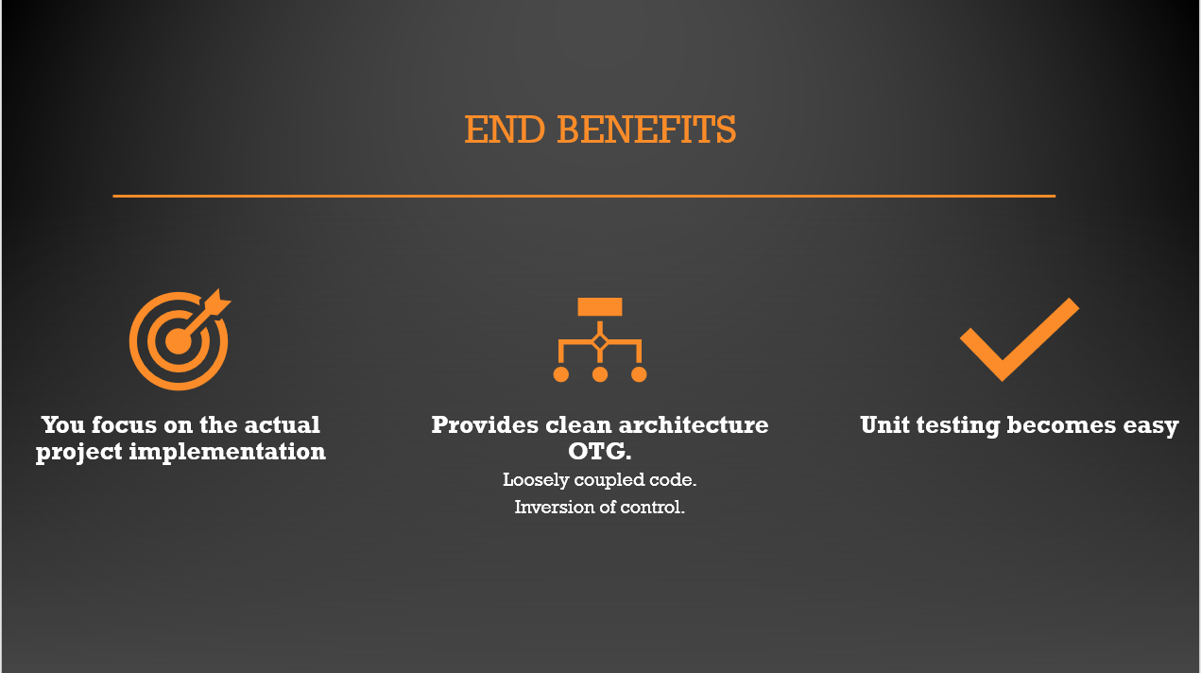
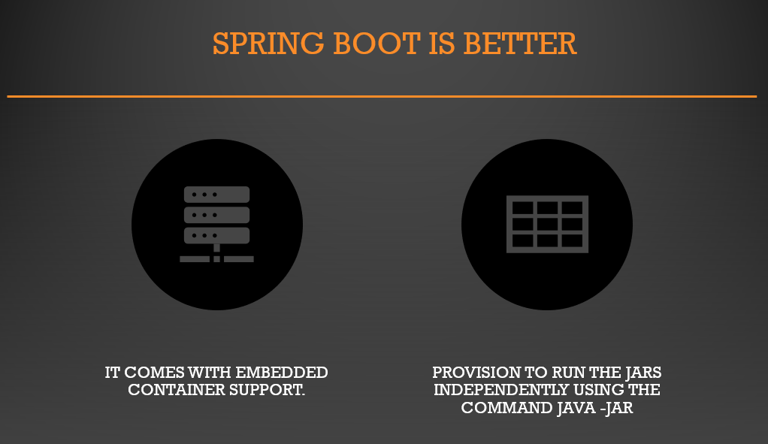
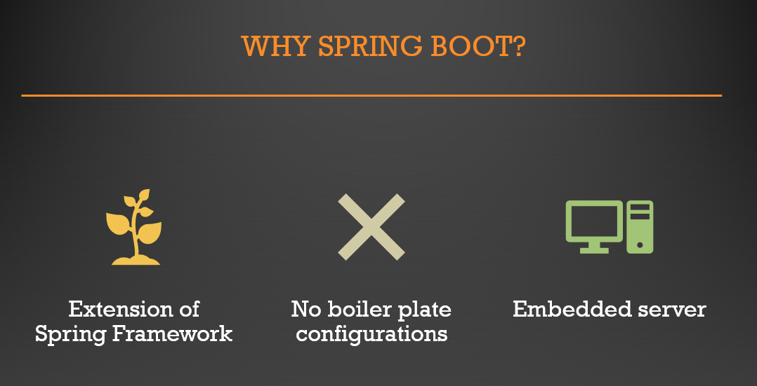
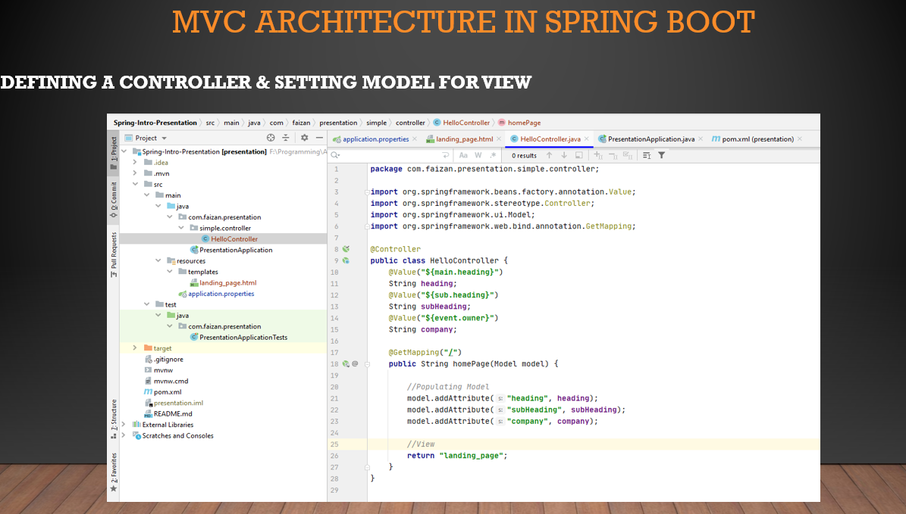
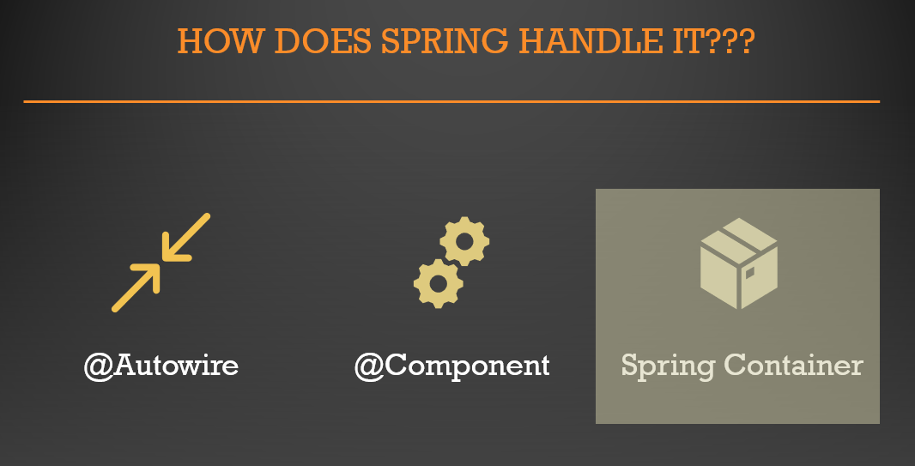
Dependency injection
Open Questions

